Slide 1

Concussions in the NFL
Group 1
Bill Taylor, Kyle O’Malley, Joel Cox

Slide 2

Motivation and Summary
We were questioning whether the awareness of head injuries has caused a decline in concussions
We asked whether rule changes and the release of the Will Smith movie “Concussion” have helped
Our answers were not conclusive and not what we hypothesized. It appears that concussions went up.

Slide 3
Questions
Did the movie decrease the amount of concussions?
Did rule changes affect all injuries or just concussions?
Is there a certain time of year that has more concussions occur?

Slide 4
The Data
We were able to get the API Sports IO
We gathered all injury data from the 2012 regular season through 2019
We created a DataFrame to answer the questions
Clean repetitive concussion injury labels to a single “Concussion” label

Slide 5
Question 1
Did the movie decrease the amount of concussions?
Alt: If the movie Concussion had an effect on the NFL, then concussion injuries would go down during the 2016 season.
Null: If the movie Concussion had no effect on the NFL, then concussion injuries would not go down during the 2016 season.
T Test= -2.90662316
Pvalue= 0.02763689

Slide 6
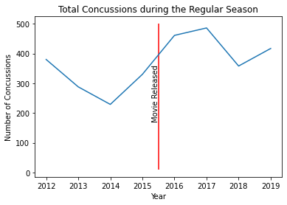
Graphics Q1
Concussions appeared to go up after the movie was released

Slide 7
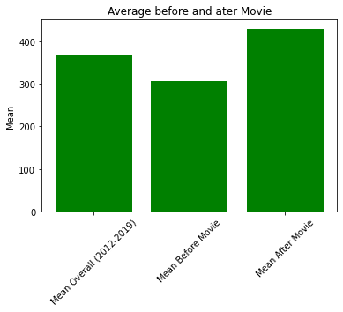
Conclusion question 1
It appears that concussions went up the seasons following movie release
The data supports the Null hypothesis
More data may prove otherwise

Slide 8
Question 2
Did rule changes in 2018 affect all injuries or just concussions?
Alt: If injuries were affected by rule changes, then injuries would go down.
Null: If injuries were not affected by rule changes, then injuries would not go down.

Slide 9
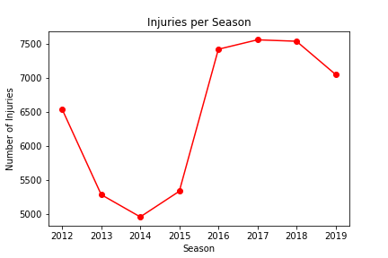
Question 2
Injuries went up in 2016, and did not decrease in 2018 with the implementation of new rules such as targeting
T-test: -2.374087
Pvalue: 0.06362946

Slide 10
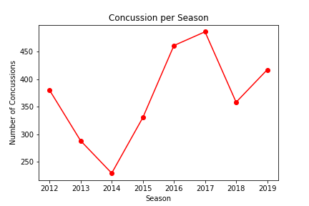
Question 2
Concussions went down in 2018 compared to the recent two years once new targeting rules were implemented
T-test: -0.618379
Pvalue: 0.56340387

Slide 11
Conclusion question 2
It appears that injuries went up the seasons following movie release
The data supports the Null hypothesis
More data may prove otherwise

Slide 12
Question 3
Is there a certain week of season more concussions occur?
Alt: If the time of year affects concussions, then there will be more concussions during a certain part of the season.
Null: If the time of year does not affect concussions, then there will not be more concussions during a certain part of the season.
T Test= 3.215721636354374
Pvalue= 0.00019897702695319134

Slide 13
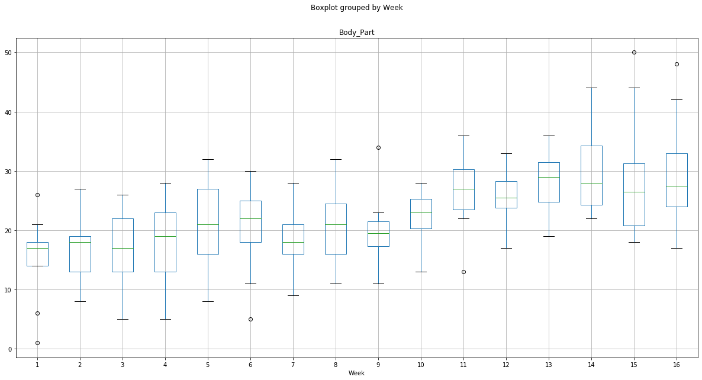
Graphics Q3

Slide 14
Conclusion question 3
There appears to be no real difference in which week of the season that concussions occur, just a slight upward trend towards the end of the season.
The data supports the Null hypothesis

Slide 15
Challenges
Finding data
Took time to clean data
Narrowing focus
QUESTIONS?

